Slide 1
Current state of regulation of shale gas regulation in the UK
Dr Sanna Elfving
s.k.elfving@bradford.ac.uk
@sannielfving

Slide 2
Introduction
No specific shale gas related legislation exists at the EU level
Member States have the right to determine the conditions for exploiting their unconventional energy resources
Commission Recommendation on minimum principles for the exploration and production of unconventional sources of energy
The UK regulatory regime for the exploration and appraisal of unconventional gas is consistent with the Commission Recommendation
The UK regulatory framework has been designed to address the environmental risks associated with hydraulic fracturing, and therefore, it is more comprehensive than in many other countries commercially exploiting these resources

Slide 3
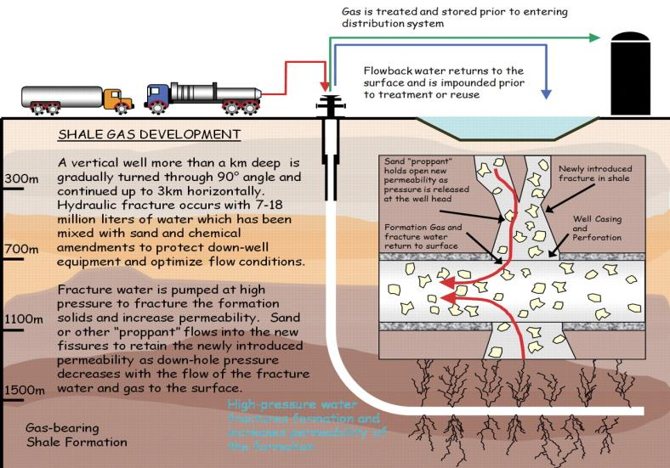
What is hydraulic fracturing?

Slide 4
First glance of the legislative framework
clear requirements for well integrity, disclosure of chemicals and the need to avoid any potentially harmful impacts on groundwater and surface water
Questions remain over environmental impact assessments, baseline monitoring (non-legislative requirement) and practicability of the regime
Current regulatory framework has been described as ‘unnecessarily complicated’ and ‘bureaucratic’
Very few permits have been issued to the industry thus far

Slide 5
Likely causes of delays
Stringent environmental requirements & lengthy licencing procedures
Multiple government departments and agencies sharing responsibilities over various parts of the regime
Underground access
Political unwillingness to proceed

Slide 6
The UK shale gas regime
No specific shale gas regime exists
Existing legislation on oil & gas development covers most aspects from the initial exploration right to the decommissioning of wells
The regulatory roadmap of the Department of Energy and Climate Change covers the exploration and appraisal phases
Actual production phase must be complemented by additional rules
Suggestions to reduce the complexity of the regulatory regime (a single body to lead the regulatory responsibilities)
Reorganisation of responsibilities may delay approval of shale gas operations

Slide 7
Licencing/consent
The process of obtaining consent to drill a shale gas well is the same as for conventional gas
Licences to explore for and produce shale gas are issued by the Office of Unconventional Gas and Oil (part of the Department for Energy and Climate Change)
Issued through a competitive process under s. 3(1) of the Petroleum Act 1998
Although s. 2(1)-(2) of the 1998 Act vests the exclusive right for searching and boring for petroleum and ownership to hydrocarbon resources to the Crown, a production licence grants exclusivity to operators in a specified licence area

Slide 8
Licencing/consent
The initial licence round does not grant a right to drill a well, operators may commence seismic surveys
Notification to landowners and the planning authorities of the plans to conduct seismic surveys
right to use deep-level land within a landward area at a depth of at least 300m below surface level ‘in any way for the purposes of exploiting petroleum or deep geothermal energy’ under s. 43 of the Infrastructure Act 2015

Slide 9
Planning permission
For exploratory and appraisal work a planning permission must be obtained from the relevant local authorities
Planning applications are determined in accordance with the Town and Country Planning Act 1990
The permission is granted for wells and well pads
Authorities are likely to scrutinise issues such as proposed location of the site; impacts on surface and ground water (a risk to fresh water resources; increased traffic volumes; possible on-site storage facilities; noise generated by activities; potential for induced seismicity and generation of waste
If planning permission is granted, the local planning authority will monitor and inspect shale gas operations to ensure compliance with any permit conditions before issuing the permit
Should the local authority refuse the planning permission, operators may appeal the Secretary of State for Communities and Local Governments under s 78 of the Town and Country Planning Act 1990

Slide 10
Environmental Permitting Regulations 2010
incorporate the requirements of the Mining Waste Directive (2006/21/EC), Water Framework Directive (2000/60/EC), Groundwater Daughter Directive (2006/118/EC) and the Radioactive Substances Act 1993
Protection of water resources, incl. groundwater aquifers
Assessing and approving chemicals
Treatment and disposal of waste produced during borehole drilling and hydraulic fracturing
Disposal of waste gases through flaring
Treatment and management of any naturally occurring radioactive materials

Slide 11
Environmental impact assessment
No compulsory environmental impact assessment is required
This process in English law is governed by the Town and Country Planning (Environmental Impact Assessment) Regulations 2011
All development subject to an EIA is defined either as ‘Schedule 1 development’, which automatically requires a screening opinion by the local planning authority
‘Schedule 2 development’ is subject to consideration by the planning authority as to whether significant impacts are likely. If a proposed project is listed in the first column in Schedule 2 and exceeds the relevant criteria set out in the second column, the proposal must be subject to a screening assessment
All applications for the exploratory and appraisal phases are likely to fall under Schedule 2(d) (extractive industry) to the 2011 Regulations, if they exceed the applicable threshold or any part of the development is to be carried out in a ‘sensitive area’

Slide 12
Water abstraction licensing
Operators who want to abstract >20 cubic metres/a day directly from surface water/groundwater need a licence and prior consent by the Environment Agency (EA)
Licences are granted, if water extraction does not harm the environment or other users
Licence is not a guarantee that water will be available
All shale gas operators must notify EA of their intention to drill a borehole under the Water Resources Act 1991 and provide details of how water resources are protected in the construction and use phases
If the EA is not satisfied, it may serve a notice on the operator to take appropriate measures to conserve water quantity and quality

Slide 13
Other regulatory regimes which may apply (in case of pollution)
The positive obligations in the Environmental Damage (Prevention and Remediation) Regulations 2009/153 require operators to notify and mitigate (and remediate) any threat of environmental damage caused
Hazardous waste regulations may apply with regard to disposal of fracking fluid, depending on chemical content
Contaminated land regime (Environmental Protection Act 1990 Pt 2A) and the common law principle established in Rylands v Fletcher (1868) LR 3 HL 330 could be relevant
Borehole Sites and Operations Regulations 1995/2038 require operators to provide HSE with advanced notice of significant alterations to wells or any risk of accidental release of fracking fluid or shale gas

Slide 14
Conclusions
Almost every aspect of shale exploration and production, (from initial exploration right through to the decommissioning of wells) is covered by existing legislation
The existing regime is sufficiently robust to mitigate impacts on the environment & human health
However, it is also rather complex to the extent that no shale extraction has taken place in the UK
Although EU level legislative framework is virtually non-existent at the moment, the EU exerts influence over the UK shale gas regime in the form of environmental Directives

Slide 15
What is your view?
Is there a case for fracking in providing the UK with greater energy security and growth?
Is the public interest being protected?
How can the adverse impacts be mitigated?
Should there be a change property rights to allow drilling without landowners’ permission?

